Slide 1




佳寶幼稚園第二分校(建生邨)
Guideposts Kindergarten
2nd Branch (Kin Sang Estate)
語文童樂：非華語幼兒中文啟導計劃
三語 (粵語、英語、烏爾都語)
親子伴讀故事

Slide 2
成品由優質教育基金撥款資助計劃—
語文童樂：非華語幼兒中文啟導計劃
（計劃編號：2014/0173）所推出

Slide 3
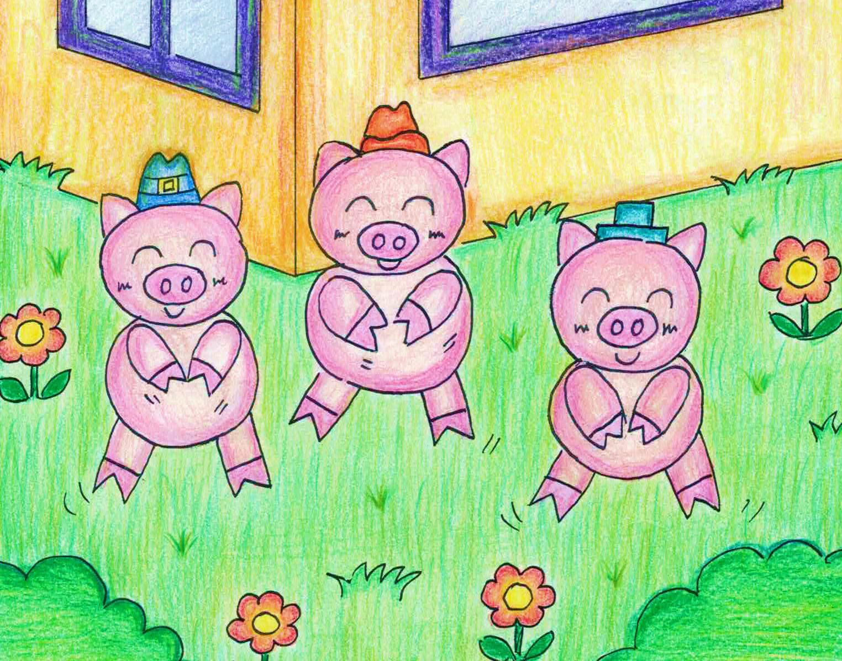
三隻小豬 The Three Little Pig

Slide 4
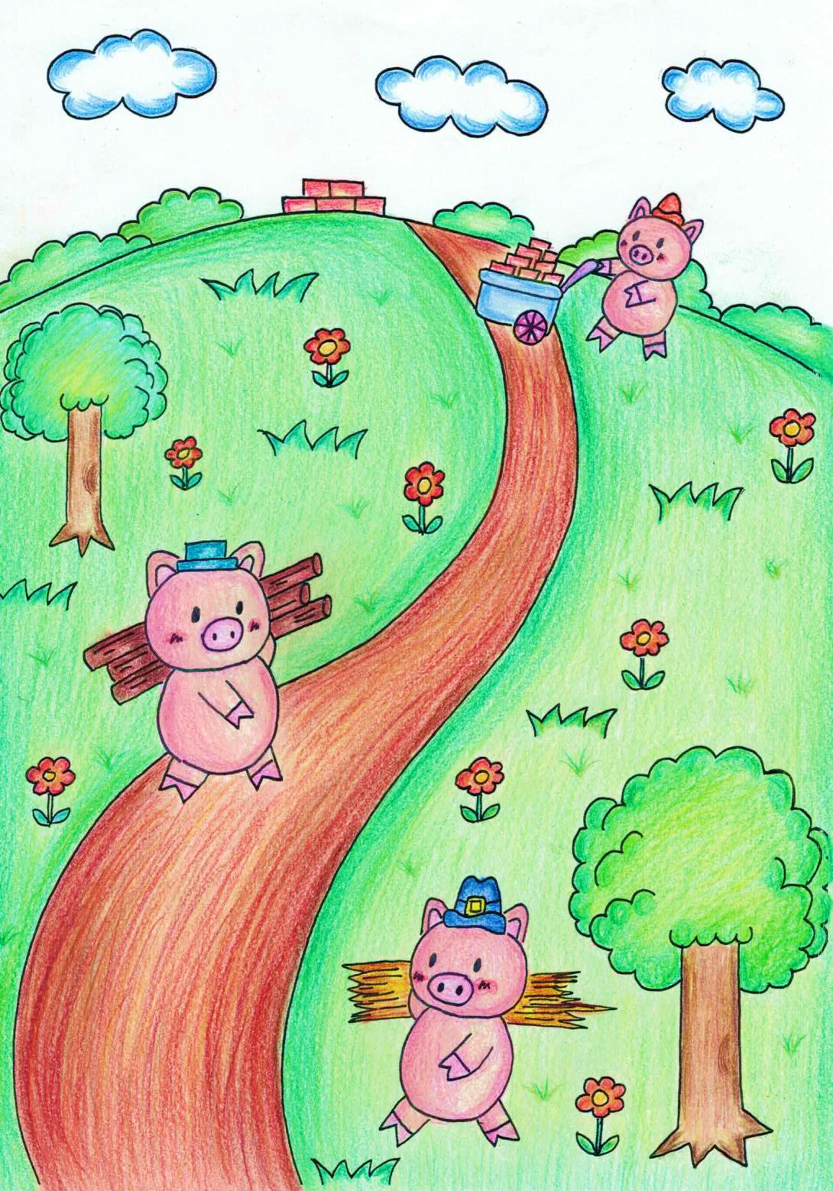

有三隻小豬，他們要自己去蓋房子。
There were three little pigs. They want to build their own house.
Teen chote suar the, wo apane ghar banana chaahate the.

Slide 5
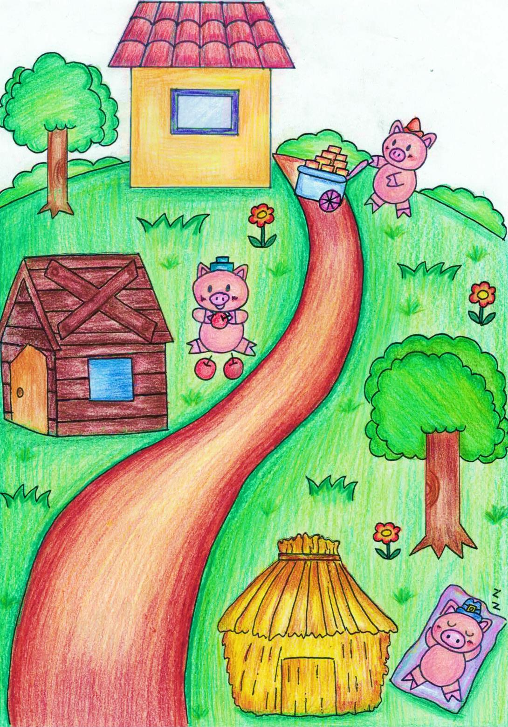
豬大哥用稻草蓋房子。
The first pig used grass to build his house.
Bade suar ne apana ghar banane ke liye ghass ka istemal kiya.

Slide 6
豬二哥用木頭蓋房子。
The middle pig used wood to build his house.
Beech wale suar ne apana ghar banane ke liye lakadi ka istemal kiya.

Slide 7
豬弟弟用石頭蓋房子。
The youngest pig used stone to build his house.
Chhote suar ne apana ghar banane ke liye patthar ka istemal kiya.

Slide 8
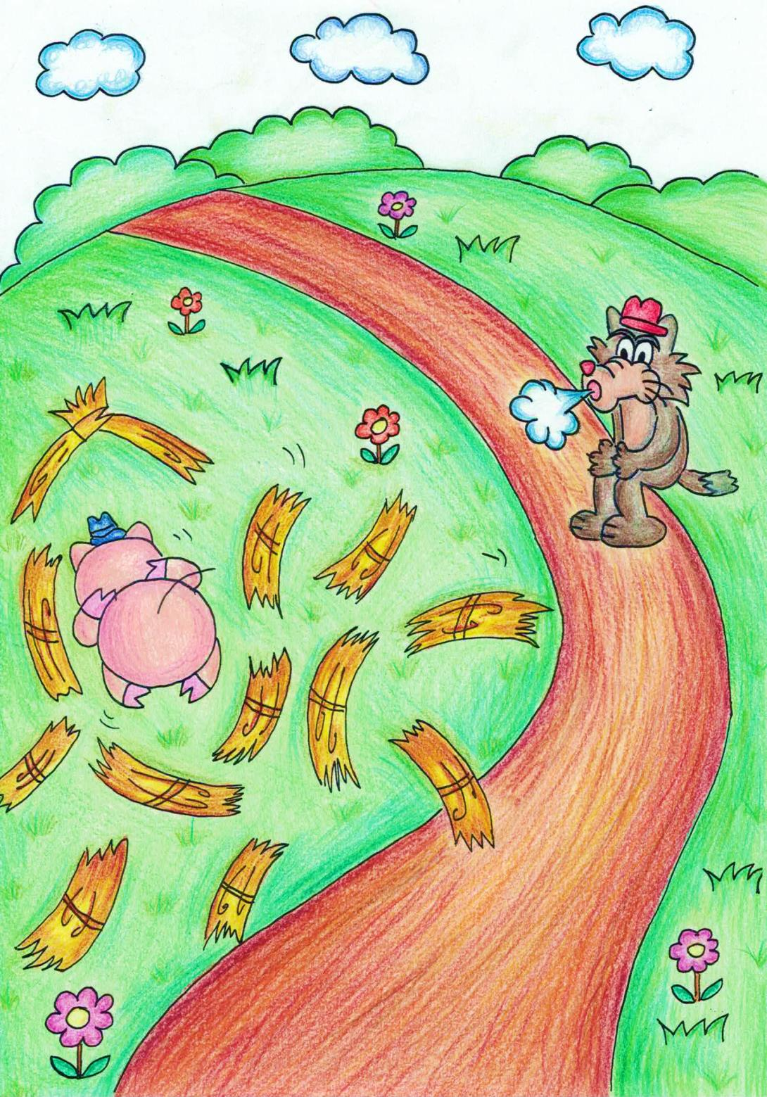
大野狼深呼吸「呼」，草屋倒下了。
The wolf took a deep breath “whoosh”, and blew the grass house down.
Bheriye ne gahari sans li“whoosh”,ghass wala ghar gir gaya.

Slide 9
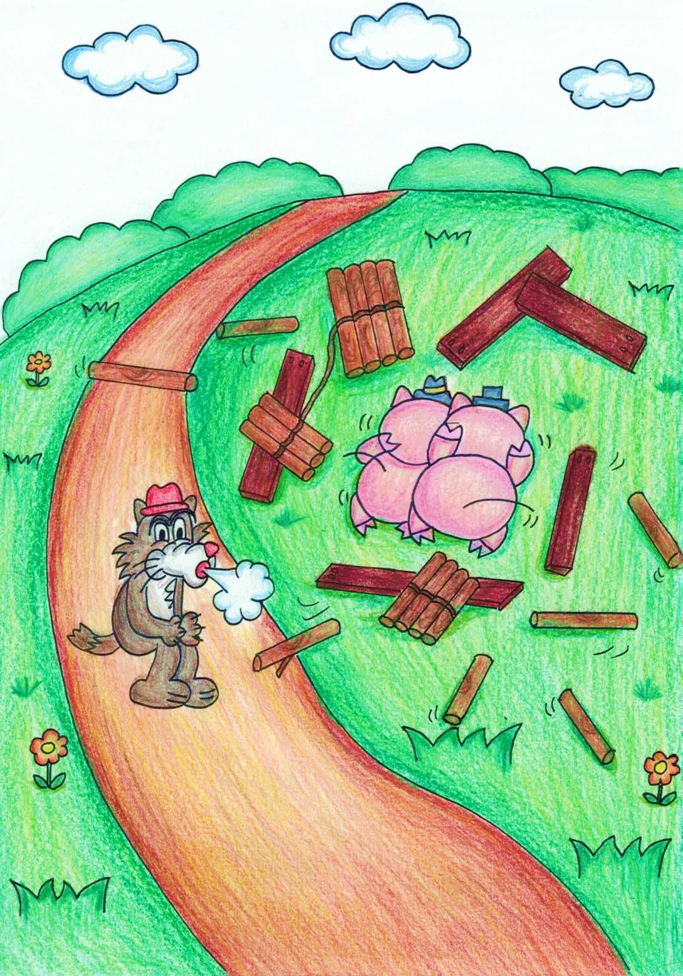
大野狼深呼吸「呼」,木屋倒下了。
The wolf took a deep breath ”whoosh”, and blew the wood house down.
Bheriye ne gahari sans li”whoosh”,lakadi wala ghar gir gaya.

Slide 10
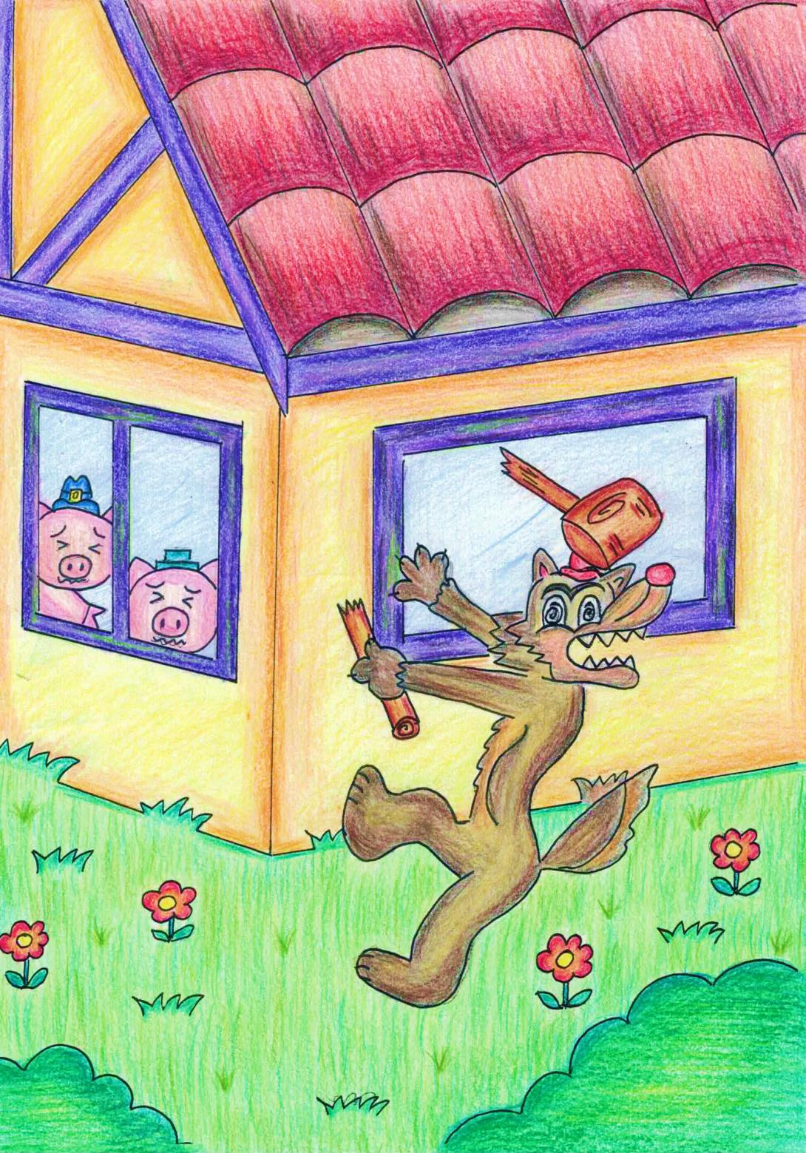
大野狼用盡辨法也不成功。
The wolf tried very hard but he still cannot succeed.
Bheriye ne bohat koshish ki lekin succeed nahi hoya.

Slide 11
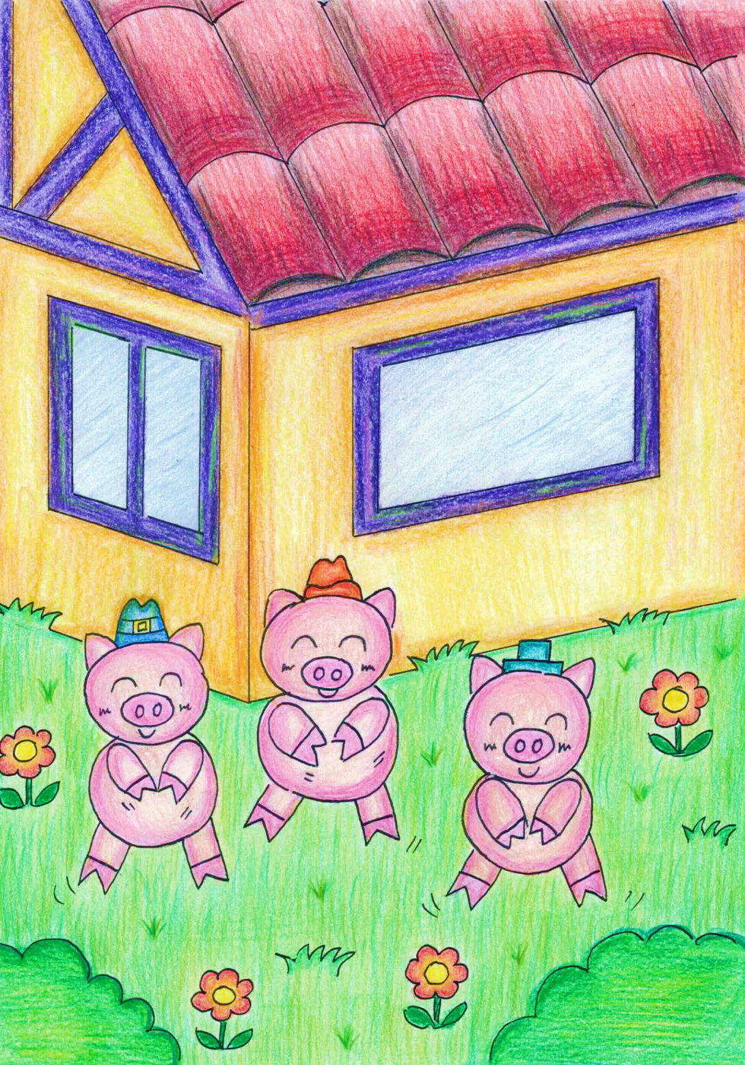
三隻小豬從此過著幸福快樂的日子。
The three little pigs lived happily ever after.
Teen chote suar khushi se zindagi bitaane lage.

